Slide 1
CEN 3078 Computer Security
Module 4 – Security Analytics

Slide 2
Security architectures
Moving target defense, Defense by pretense
Anomaly detection
Threat intelligence collection
Penetration testing
Risk assessment and management
Module-4: Discussion Topics

Slide 3
Security architectures
Moving target defense, Defense by pretense
Anomaly detection
Threat intelligence collection
Penetration testing
Risk assessment and management
Module-4: Discussion Topics

Slide 4
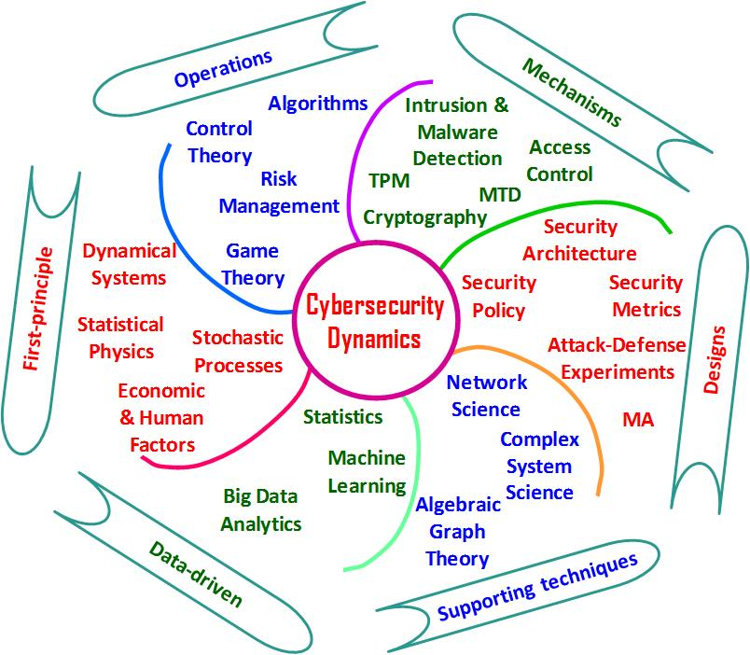
Data Science/ML and Cybersecurity
Data science/machine learning is critical to reveal “evidence” in cyber attack incidents
Without (good) data, there is no knowledge
Time-series data can be valuable for descriptive and predictive analytics of anomaly events
Useful for malware research, penetration testing, etc.
Threat intelligence collection supported by data is critical for decision making in real-life cyber operations/risk management
Helps cybersecurity engineers prioritize and focus on critical events than working by instinct
Many large organizations are hiring data scientists to help with cybersecurity analytics
4

Slide 5
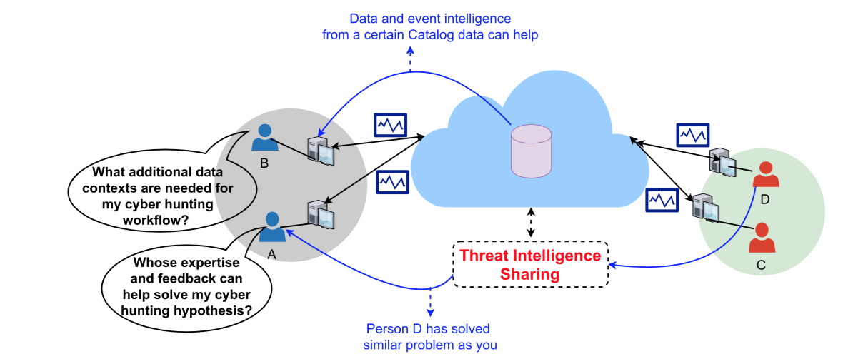
Data-driven Cyber Intelligence Collection
Threat intelligence sharing helps a cyber analyst’s monitoring objectives for ‘soft critical events’ and ‘silent critical events’ relating to either performance bottlenecks that may relate to security incidents…
5

Slide 6
Data-driven Cyber Intelligence Collection
Need to use statistical data planning policies in systems by considering variations of data structures of the many data silos involved
Active measurements (ping, traceroute, Iperf or other such one-end or double-end measurement probing)
Passive measurements (Netflow records, DNS, pcap, host logs, crash dumps, process logs, memory logs)
Monitoring objectives drive network and host device data collection, storage and analysis/visualization in cyber threat hunting
”Data farming” needs to be synergistic to “Data mining”
Monitoring strategies for expected performance/safety assurances violations due to ‘soft failures’ or ‘silent failures’
Versus ‘hard failures’ or ‘failure alarms’ where faults are more apparent to operations personnel using traditional monitoring systems or intrusion detection systems
6

Slide 7
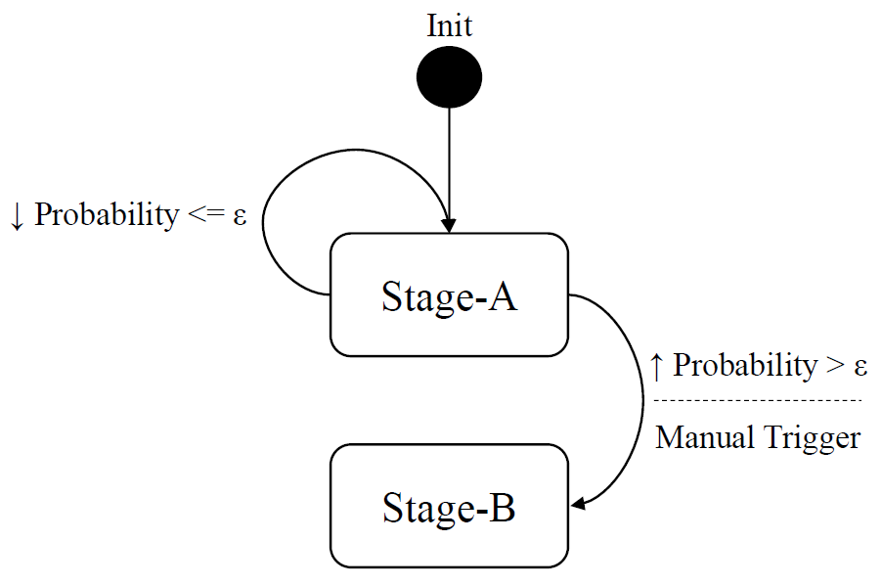
Two-stage Ensemble Learning
Attack feature analysis is done using a two-stage ensemble learning scheme:
Stage A: Outlier Detection
Stage B: Outlier Classification
Epsilon is probability that an event is an outlier – it is tuned in the training phase
If probability is higher than epsilon or if it is manually triggered, the scheme enters Stage B
7

Slide 8
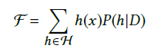
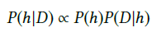
Outlier Detection
Composition of many efficient, multivariate outlier detectors or hypotheses functions
Detect network-wide correlated anomaly events
Functions:
Ensemble of hypotheses
Final ensemble result
Attack probability function
The posterior probability is proportional to the likelihood of the training data D times the prior probability of h
8

Slide 9
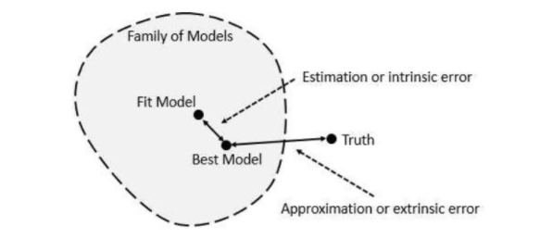
Outlier Classification
Detected attacks are classified into either:
Interesting events (e.g., attacks)
Erroneous conditions (e.g., router failure)
If final ensemble results of consecutive events fall in same range, we classify as an attack, else the events are ignored
NOTE: Ground truth (in addition to high quality data) is extremely important in order to evaluate the accuracy of detected attacks
9

Slide 10
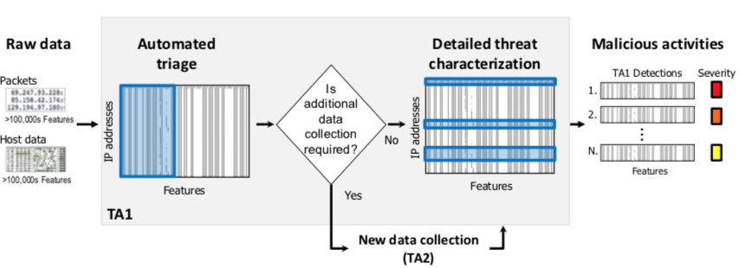
Threat Detection and Characterization
Efficiently detect and characterize cyber threats in a manner that adapts to available data and resource limitations - “sensors for right data at right time”
Detect malicious actions that threaten the integrity of enterprise networks through techniques that integrate information from both networks and hosts
10

Slide 11
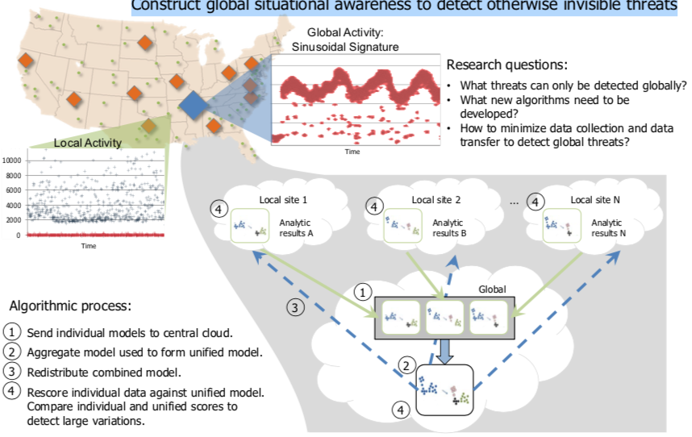
Global Analysis of Threats
Construct global situational awareness to detect otherwise invisible threats
Focus on malicious activity that is invisible from the perspective of a single network, but becomes apparent when multiple systems share the right data
Address what computations need to occur locally, what information must move between locations, and what computations must occur at a central repository
11

Slide 12
Emerging AI Technologies for Cyber Hunting
AutoML - capability of automating the process of building, deploying, and managing machine learning models
Amazon SageMaker, Big Squid (self-service ML workbench), RapidMiner (visual ML workflow designer)
Augmented Intelligence - human-centered partnership model of people and AI working together
Enhance cognitive performance, including learning, decision making, and new experiences
Explainable AI - an ensemble of methods that make black-box AI algorithms’ outputs sufficiently understandable
Edge AI - use of AI techniques embedded in IoT endpoints, gateways, and edge devices to act on sensor data
Applications in streaming analytics for “right data at right time”
https://cra.org/ccc/wp-content/uploads/sites/2/2019/08/Community-Roadmap-for-AI-Research.pdf

Slide 13
Amazon SageMaker
Amazon SageMaker - fully managed service to label, build, train, and deploy ML models quickly
Amazon SageMaker Notebooks, Active learning for ground truth

Slide 14
Explainable AI (XAI)
ML models in new age of applications are opaque, non-intuitive
XAI improves understanding, trust for people

Slide 15
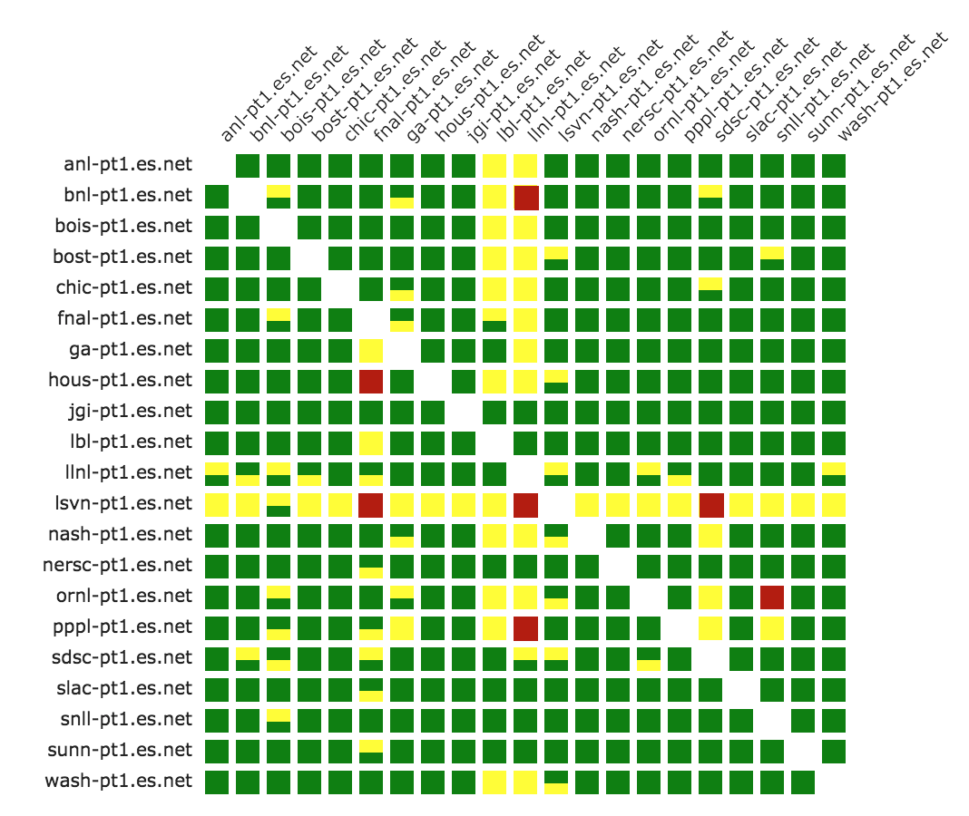
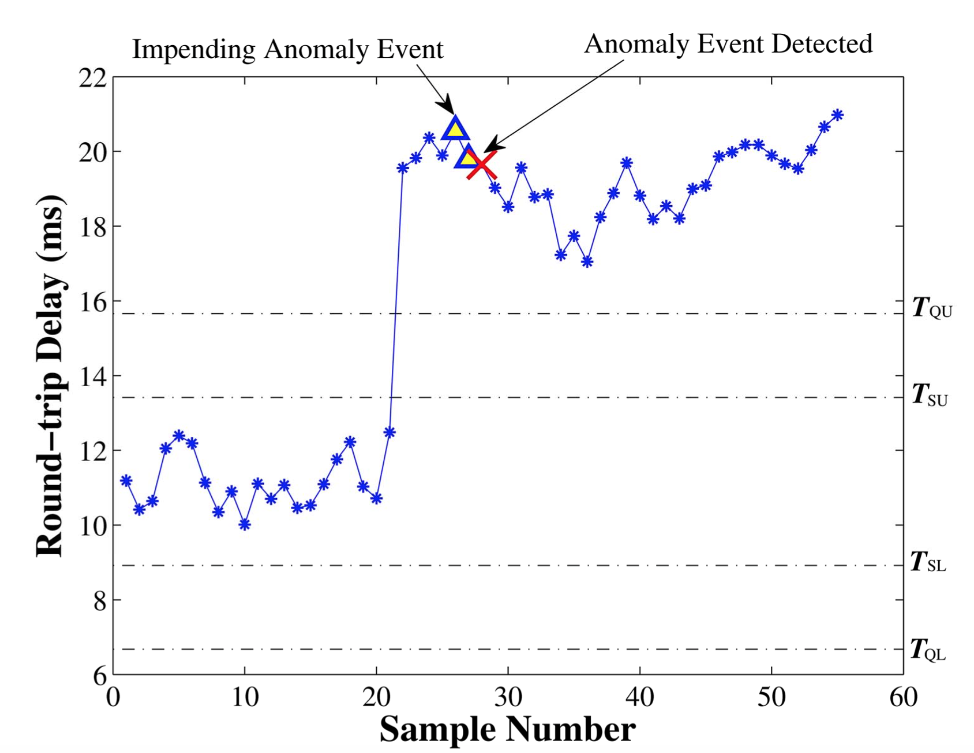
Explainable AI (XAI) Case Study
Anomaly detection → network-wide bottleneck event diagnosis or cyber attack detection/mitigation
→

Slide 16
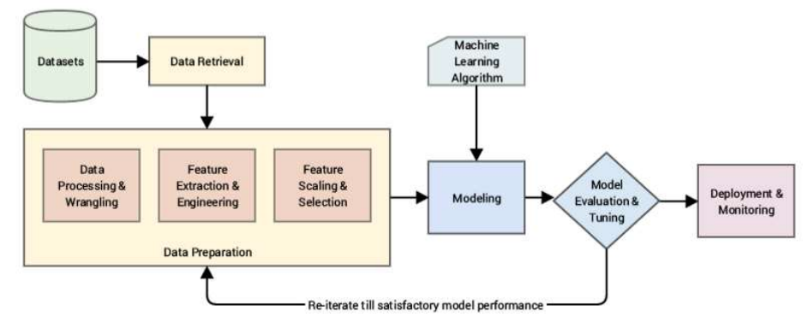
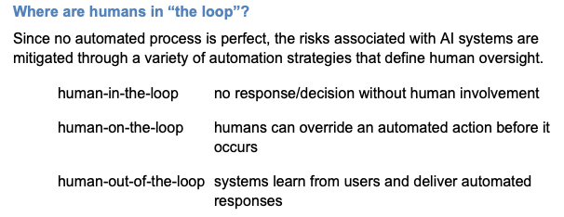
Typical ML Steps
Data used to test a system should be representative of the data the system will see
ML for Cybersecurity Videos: https://www.youtube.com/channel/UC6qyO5J_rObFJewJWs89XRA/videos

Slide 17
Common Anomaly Detection Analysis Schemes
Statistical Techniques
Identify anomalies without assuming a stochastic model in the measurements
Classification Techniques
Identify the root-cause of anomalies through behavior observation (uses offline training/labeling; online testing on unlabeled measurements for category assignment)
Clustering Techniques
Category is not known apriori but placing data points that are similar close to each other – create category based on some distance function
Expert System Techniques
Root-cause analysis by imitiating knowledge of human expert; rule-based or model-based
Graph-theoretic Techniques
Causality (cause-effect) or dependency graph representations; algorithms help test various hypotheses or data perspectives

Slide 18
AI System: “Smart” Workflow to Knowledge-driven Decision Making
Sensing (Assess/Data)
Recognize important patterns/events in space and time
Filter out the noise
Trust in the data
Reasoning (Infer/Learn)
Turning patterns/events and their relationship into knowledge
Logic-based inference / evidence-based inference
Local/global situation assessment / similarity checking
Building/using knowledge base/catalog with successful example cases
Acting (Predict/Fix)
Establish communication goal and generate dialog for a specific crisis
Planning / Problem Solving using model predictions
Robotic Control using software-defined technologies

Slide 19
Security architectures
Moving target defense, Defense by pretense
Anomaly detection
Threat intelligence collection
Penetration testing
Risk assessment and management
Module-4: Discussion Topics

Slide 20
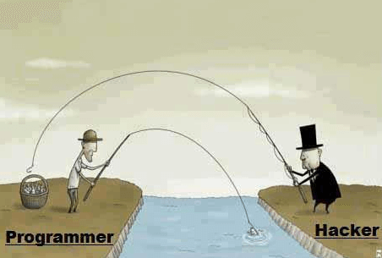

Hacking Humor Hackers find a way!
Minimum human supervision

Slide 21
Ethical Hacking (Recall)
Ethical hackers learn and perform hacking in a professional manner, based on the direction of the client, and later, present a maturity scorecard highlighting their overall risk and vulnerabilities and suggestions to improve
New worms, malware, viruses, and ransomware are multiplying every day and creating a need for ethical hacking services to safeguard the networks of businesses, government agencies or defense
An Ethical Hacker answers the following questions:
What kind of vulnerabilities does an attacker see?
What information or system would a hacker most want access?
What can an attacker do with the information?
How many people notice the attempted hack?
What is the best way to fix the vulnerability?
Minimum human supervision
https://www.eccouncil.org/ethical-hacking/

Slide 22

Types of Ethical Hackers
White Hat Hacker
Do not intend to harm the system or organization but they so, officially to penetrate and locate the vulnerabilities, providing to fix them and ensure safety
Black Hat Hacker
They are non-ethical hackers performing hacking to fulfill their selfish intentions to collect monetary benefits
Grey Hat Hacker
Combination of white and black – they hack without any malicious intent for fun; don’t use approval from a targeted organization and publicly disclose any vulnerability
Minimum human supervision

Slide 23
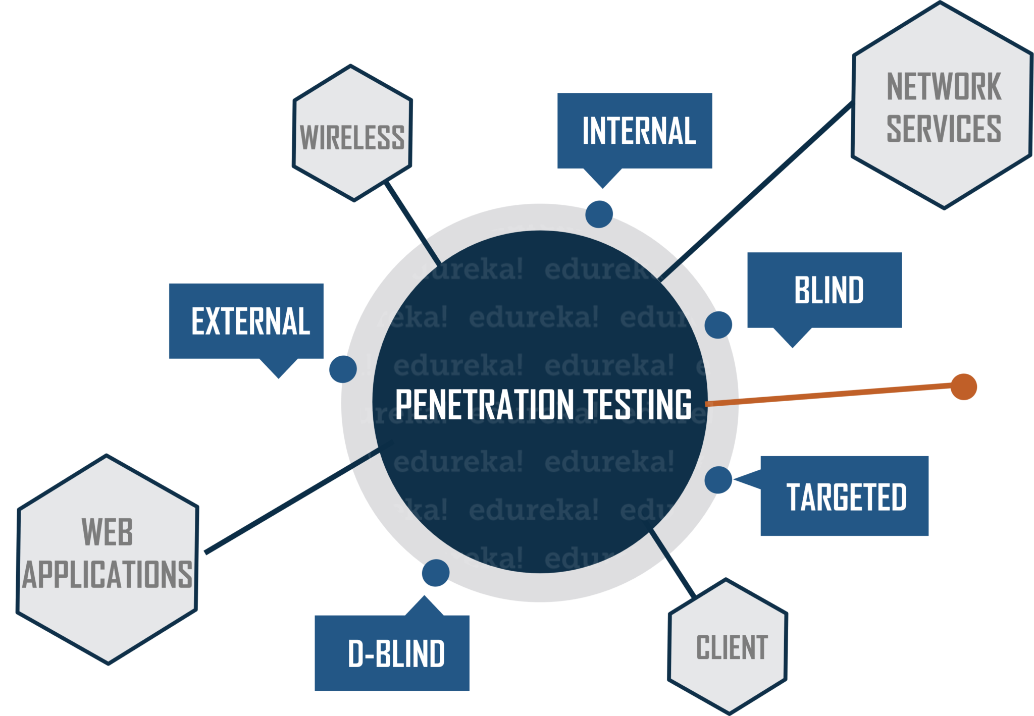

Penetration Testing / Pen Testing
Evaluate security of an IT infrastructure by safely trying (i.e., ethical hacking) to exploit vulnerabilities with written permission
Performed at different levels e.g., OS level, web apps level, wired/wireless network services level, end-user level, …
Assessment to help identify misconfigurations, risky user behavior and validate the efficacy of defense mechanisms
Goal is to find vulnerabilities before any attacker
Two types of Pen Testing
Black box: testing external components targeted with public or zero-day exploits (Black Hat)
White box: testing internal components (White Hat)
Could combine for Grey box testing
Minimum human supervision

Slide 24
Penetration Testing / Pen Testing
Manual or automated approaches are used
Pen tester goal is to exploit a particular vulnerability and use compromised hosts to launch new exploits at other internal resources
Document the combination of vulnerabilities exploited in a particular sequence
Testing ends if highest level of privilege escalation or highest levels of security clearance is attained
A report is produced for decision makers with:
Exposed vulnerabilities in terms of attack surfaces
Strategic conclusions on impact on business and operations
Priorities for remediation against threats and attack vectors
Approvals needed for fixes
Notifications are sent to relevant stakeholders e.g., senior management, vendors of hardware/software
Pen Tester must close out work (e.g., backdoors to maintain access, etc.) to avoid someone else from exploiting the vulnerabilities later
Minimum human supervision

Slide 25
Penetration Testing Steps
Information Intelligence
Using tools such as nmap, nslookup, people finders/Google search
Performing people profiling to target (e.g., via email or phone) as part of social engineering
Scanning and Enumerating
TCP and UDP port scanning to learn about target environment and find exposed vulnerabilities
Using tools such as metasploit, nc, nessus for high-speed discovery, configuration auditing, asset profiling, sensitive data discovery
Advanced Fingerprinting
Advanced fingerprinting of web applications, DNS, load balancers, etc. using scanning methods
Vulnerability Assessment
Overlaps with Pen Testing but largely non-intrusive to identify vulnerabilities in systems/networks and analyze security posture
Minimum human supervision

Slide 26
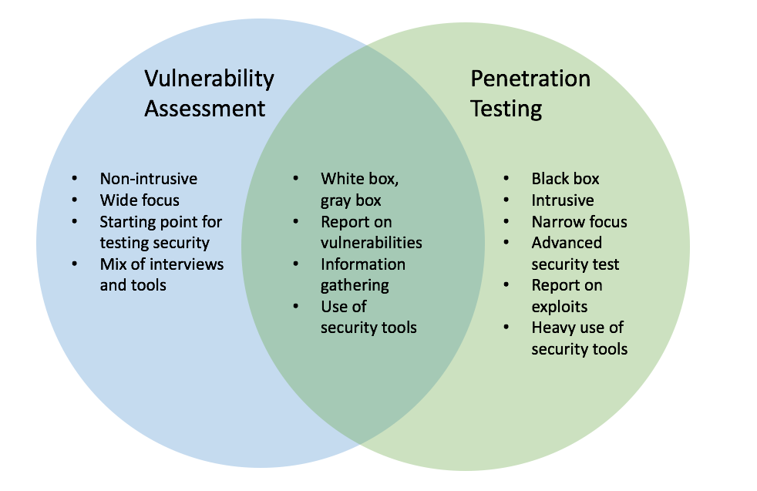
Vulnerability Assessment and Penetration Testing (VAPT)
Which one to choose and when, VA or PT? How do they differ from a security audit to check compliance with standard security policies and procedures?
Minimum human supervision
Automated/cheaper, minutes, scheduled, passive, “breadth over depth”
Popular Tools: Nessus, OpenVAS, Nikto, SAINT
Often manual/expensive, days, opportunistic/intuitive, aggressive, “depth over breadth”
Popular Tools: Metasploit, Kali Linux, NetSparker, Core Impact, Aircrack-ng, John Ripper, backtrack, wireshark
Notes:
Example:
We shall get into a real-life example to understand the difference between the two.
Let’s take Mr. X for an example. Mr. X is a heist specialist. We shall observe his plan for his next heist. He is planning to rob a Bank present in the middle of the city.
The Bank building is surrounded by a Police station, a Fire station, a Public Park [which stays closed at night] and a Pond. The bank building is a 20 floored building with a helipad on the top of it. Before he actually robs the bank, he needs to find the possible entry points into the Bank building.
The sides of the building that has a Police station and Fire station are impossible to breach. They operate 24X7 and who would dare to rob a bank using Cop’s den as the entry point! That leaves Mr. X with 3 other options. Yes, you got it right. He is also having the Roof as an Entry point [Remember Heath Ledger from the Batman Trilogy?].
The Rooftop seems to be an odd choice here as the building is only 20 floored and the chances of getting caught from people around you is very high. And, the Bank is the only single high rise building standing in the area. So, that makes the Roof entry a big NO! With the two leftover options, Mr. X starts analyzing the Lake as an entry point.
Lake can be a good mode of entry but, the visibility would be a concern. How would someone react if they see someone swimming at the midnight, that too towards the Bank building? The last option is the Public Park.
Let’s analyze the park in detail. It is closed to the public after six in the evening. Park has a lot of trees which gives the necessary shadow and supports for stealth mode. The park has a boundary wall which is shared with the Bank premises.
Now, all the analysis above can be said as Vulnerability scan. A scanner does all these things. To find out a vulnerable position to get in.
Going back to our story, let’s assume that Mr. X becomes successful in entering the bank through the Public park entry point. What does he do next? Whether he breaks into the Vault to get the cash or the deposit lockers to get the valuables.
This part is the Penetration testing. You get the access and try to exploit the system. You get to know the depth that you can go with this attack.

Slide 27
Vulnerability Assessment – dealing with Myths
“I have a firewall or use anti-virus to fend off attacks”
+) Firewalls can be effective to mitigate threats and isolate/protect
-) Hackers understand firewall strategies; can take down or by-pass a firewall through exploiting software bugs or admin oversight
-) End-to-end session hijacking not detectable by firewalls
“Web security is handled by using HTTPS”
+) Encryption of communication from source to destination is secure
-) Not effective against DDoS, brute force attacks, SQL injection
-) Organizations can be compromised by fake SSL certificates
“Our systems and data are not worthwhile targets”
+) Small business enterprises may not be attractive targets
-) More easy to attack since they may not take security seriously
-) Ransomeware attacks are frequent and impact small businesses
Minimum human supervision
Many other vulnerabilities: weak passwords, OS command injection, buffer overflow, privilege over-provisioning, unrestricted uploads of dangerous file types, outdated software, …

